Slide 1



Studio Shodwe
FORECASTING FOOD DELIVERY DEMAND USING WEATHER & TIME
Capstone Project
Group Members:
Priyank Patel
Neel Patel

Slide 2
Studio Shodwe
Our Vision
The purpose of this project is to create a model to predict the number of food delivery orders for any day based on the weather conditions such as, temperature, raining, wind speed and time of the day like morning; afternoon; evening, or night. The model shall give the delivery platforms information regarding when customers demand delivery services most, which shall enhance planning how best to meet those needs.

Slide 3
Studio Shodwe
Data and Features:
Programming Language: Python
Libraries: Pandas, NumPy, Scikit-learn, Matplotlib, Seaborn for data visualization
Tools: Google Colab
Dataset: Kaggle or other publicly available datasets

Slide 4
Key Features:
Weather Conditions: Clear, Rain, Snow, Cloudy and Sunny.
Time of Day: Morning, Afternoon, Evening, Night.
Temperature and Wind Speed.

Slide 5
Methodology:
1.Data Collection: Gather historical data, including food delivery counts, weather data (temperature, precipitation, wind speed), and time of day.
2. Preprocessing: Clean the dataset, handle missing values, encode categorical data (e.g., weather condition and time of day), and normalize numerical values.
3. Model Training: Train a machine-learning model, such as a Random Forest Regressor, on the cleaned data to predict delivery demand.
4. Evaluation: Use metrics like Mean Squared Error (MSE) and R-squared to evaluate model performance on test data. (Food-Delivery-Time-Prediction-Model, n.d.)
5. Visualization: Create graphical representations (e.g., bar graphs) to compare predicted deliveries for different dates and times.
6. Deployment: Create an easy-to-use application for businesses to input weather and time parameters and receive predicted delivery demand

Slide 6
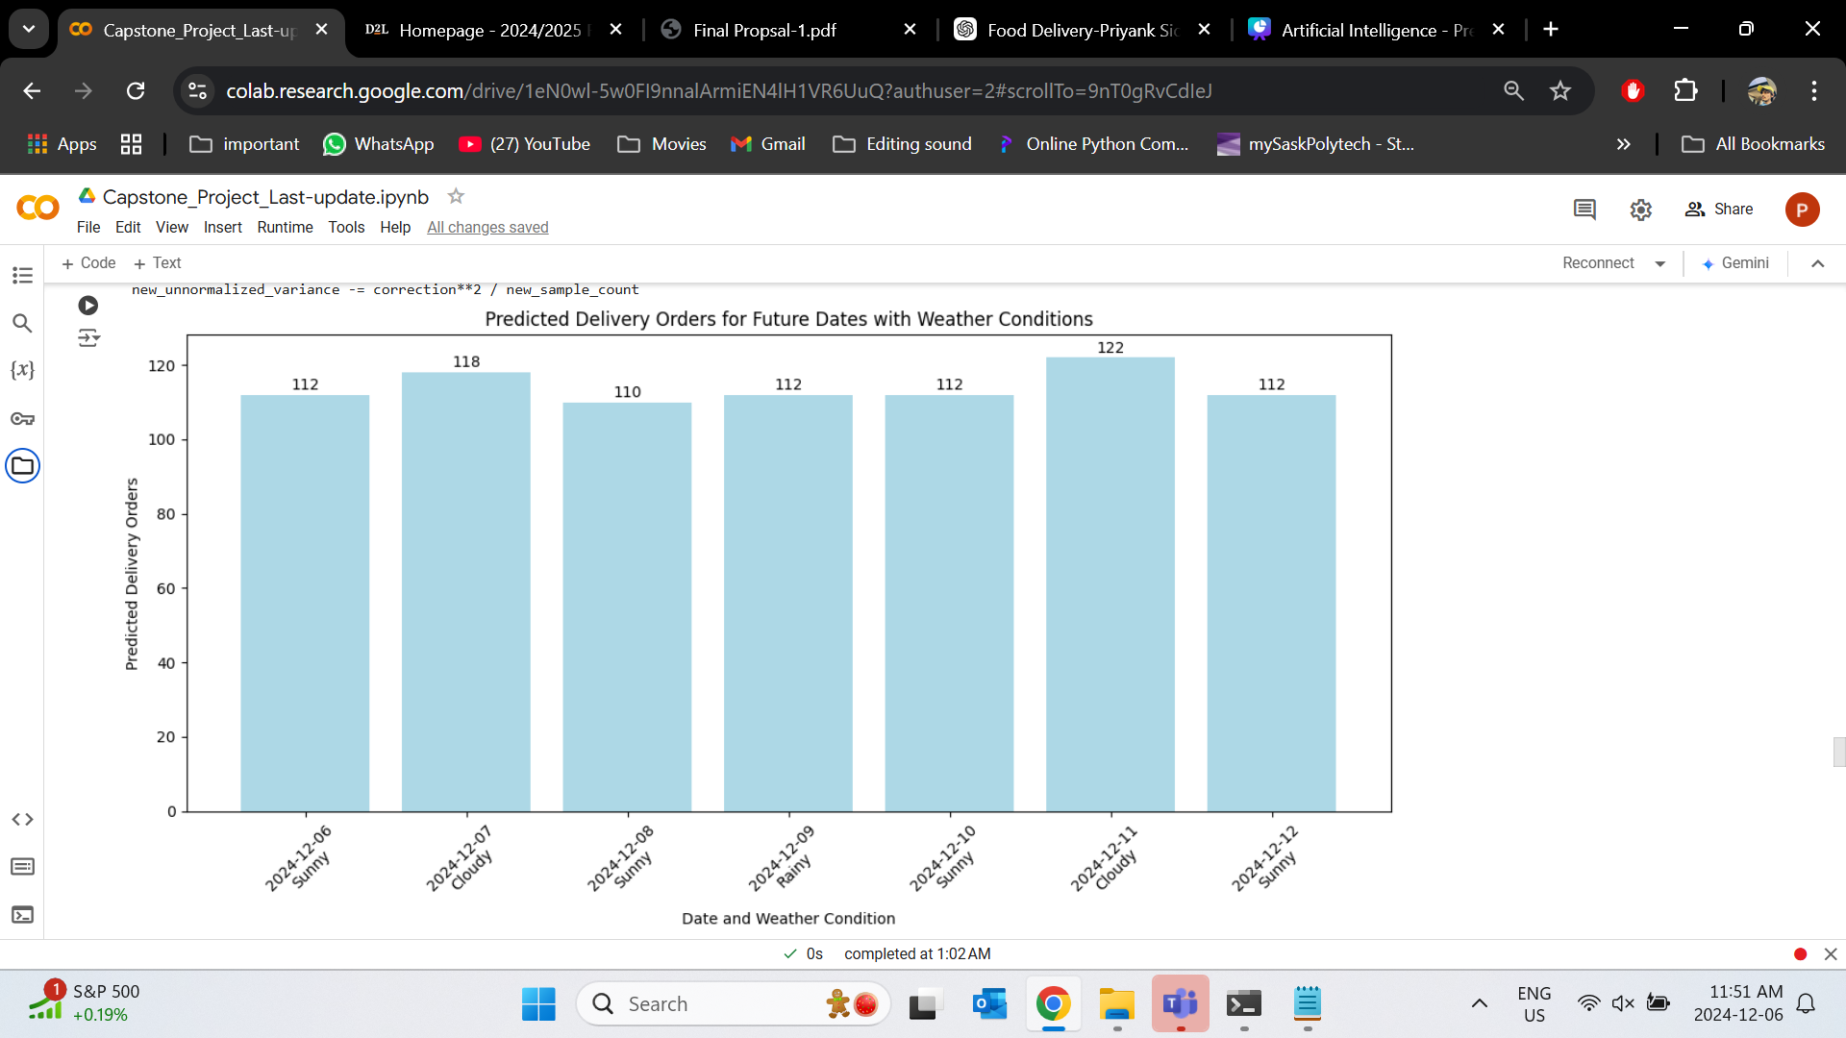
Achievements:
Feature Engineering:
Day of the Week: Some days might have different delivery patterns (e.g., weekends may have more orders).
Time of Day: morning, afternoon, evening, and night patterns.

Slide 7
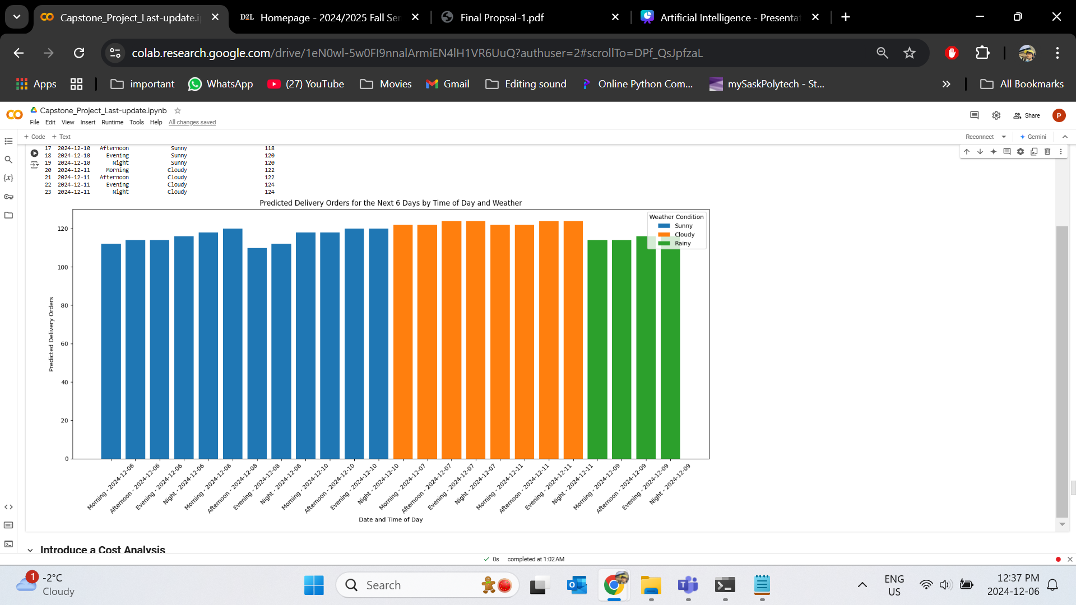
Visualization of Time-Based Predictions
To achieve unique delivery order predictions for each combination of date and time of the day, we need to add variability to the input features for each time of the day.
Introduced variations in features (Temperature, Precipitation, WindSpeed).
Added Sunny, Rainy, Snowy, or Cloudy to predictions based on feature values.

Slide 8
Introduce a Cost Analysis:
Metric
Delivery Costs (fuel, time, resources).
Revenue (from the predicted orders).
Add a profit/loss analysis based on the predictions.
2.Parameter
Base Cost per Order: $5 CAD.
Distance Cost: $0.5 CAD/km.
Revenue per Order: $15 CAD.

Slide 9
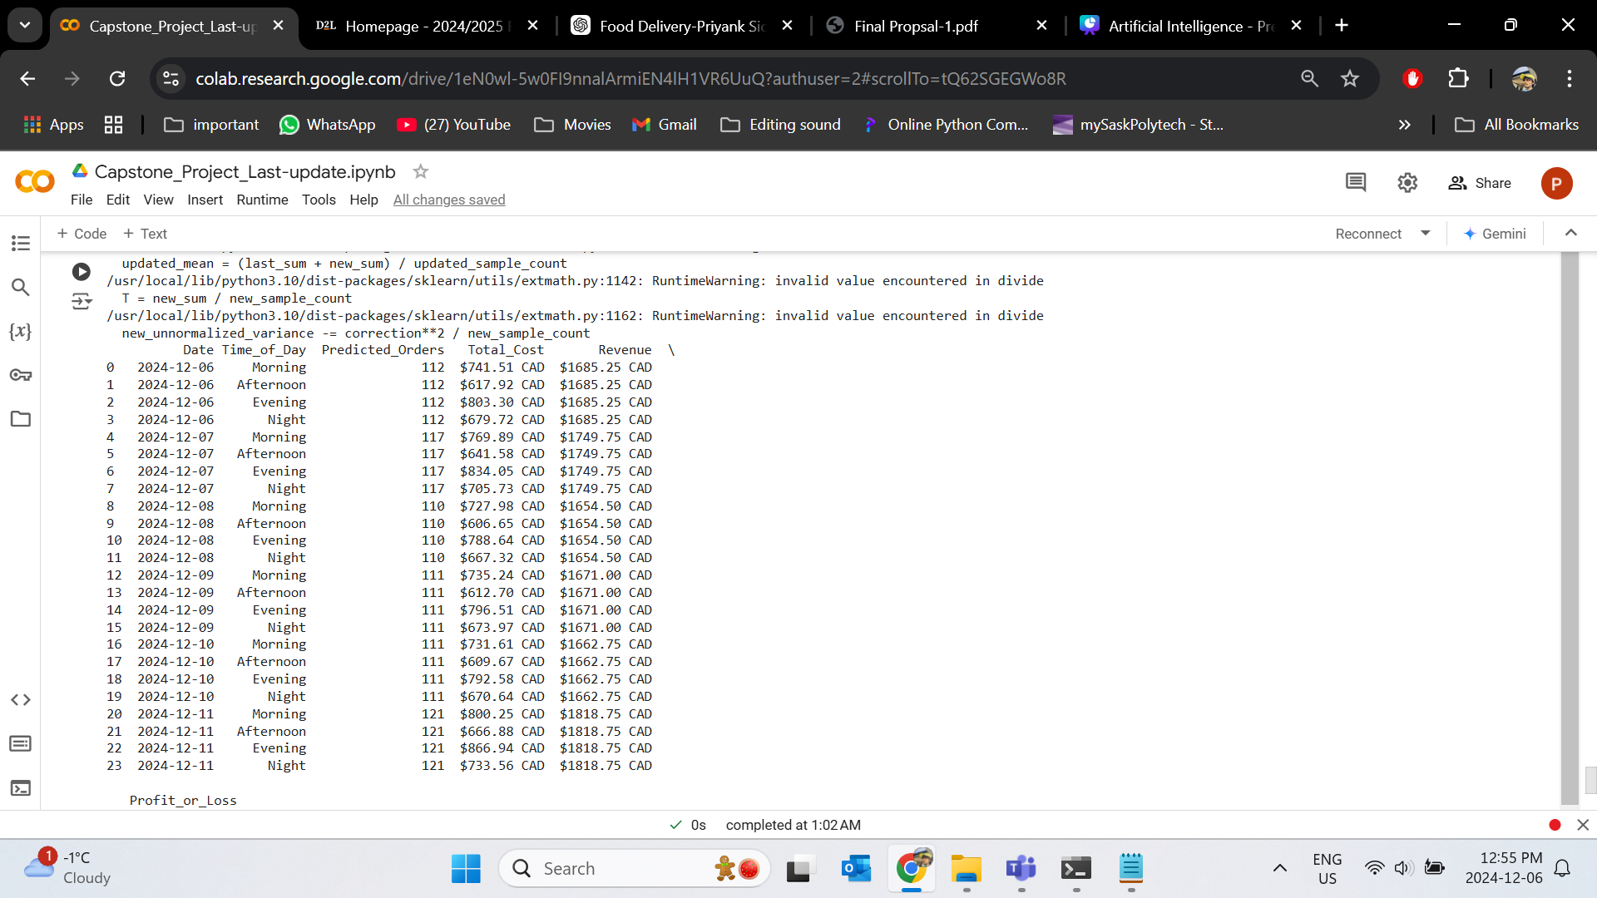
Achievement
Studio Shodwe

Slide 10
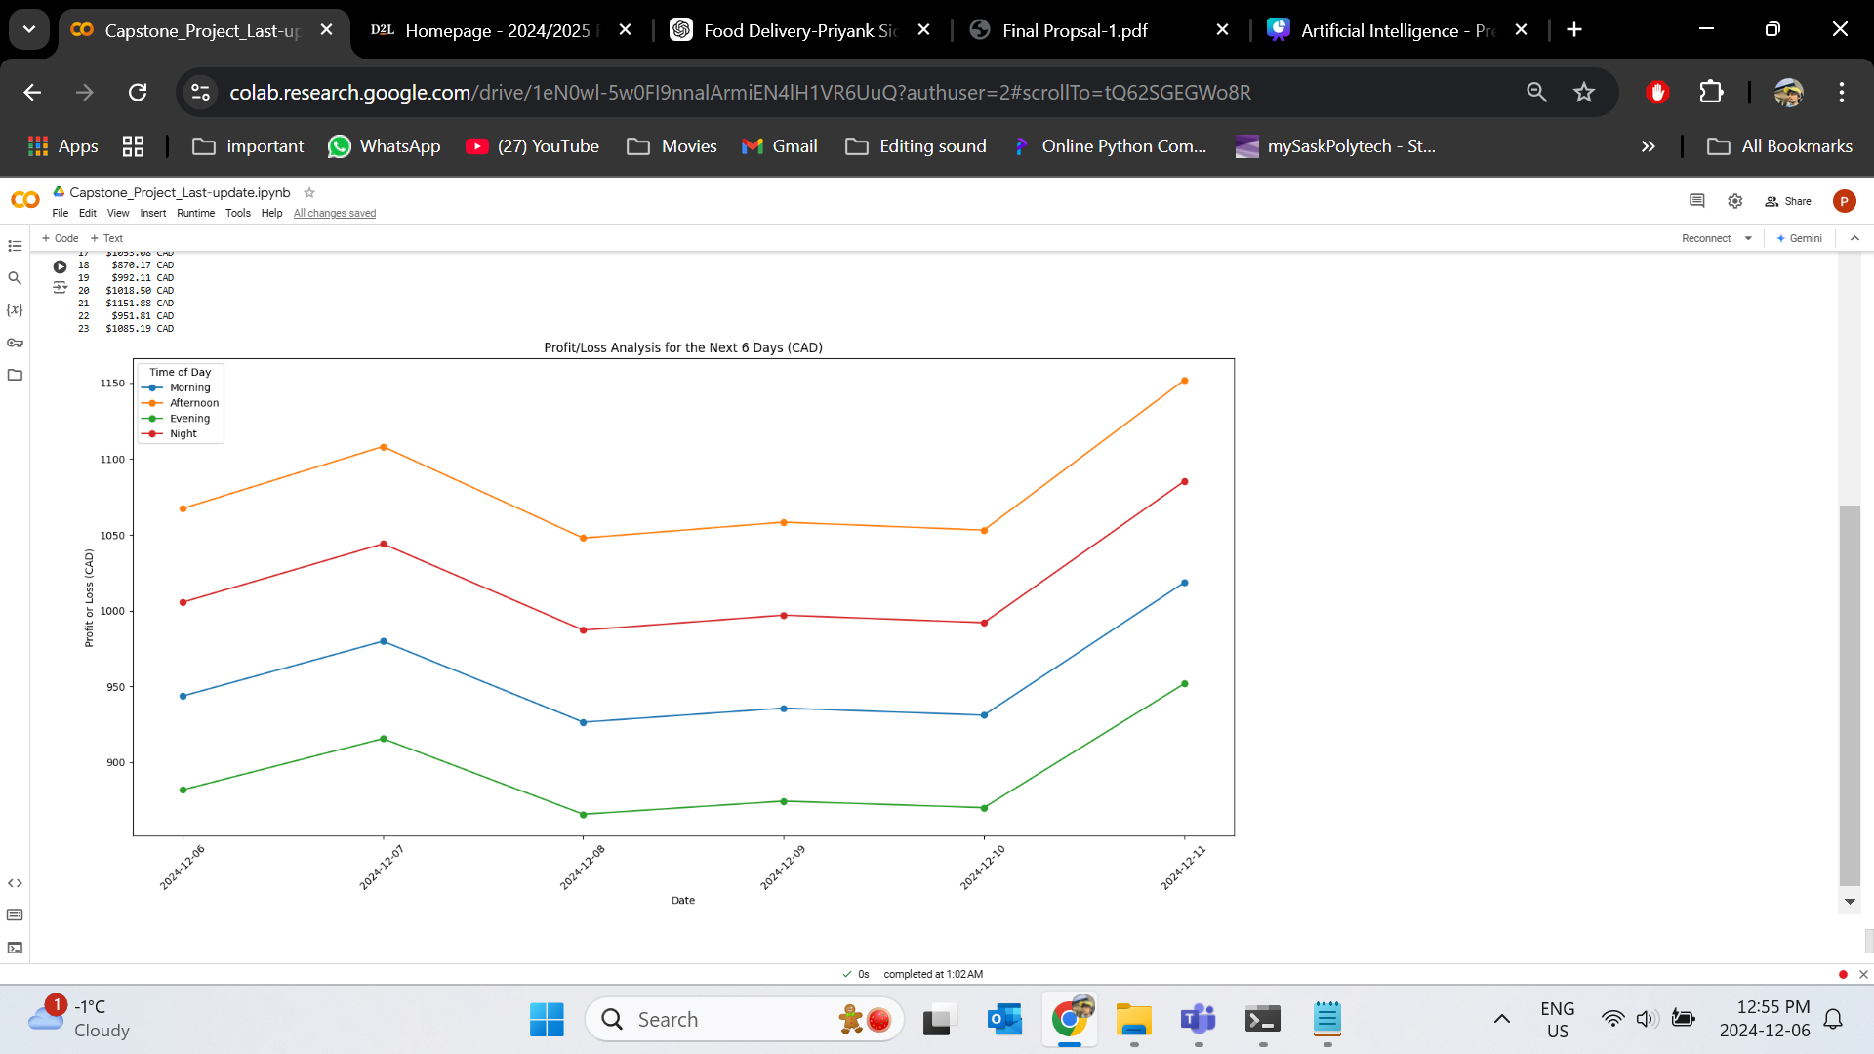
Achievement
Studio Shodwe

Slide 11
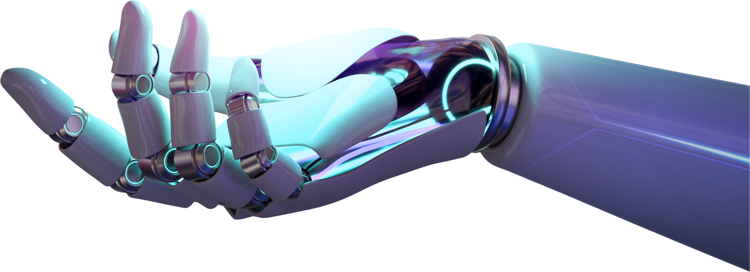
Studio Shodwe
What Makes This Project Unique:
Integration of cost and revenue analysis.
Scenario simulation for different weather conditions.

Slide 12
Conclusion:
This project aims to build a predictive model to forecast food delivery demand based on weather the goal of this work is to use the weather and the hour of the day as inputs to the model, which is to predict demand for food delivery in the future.

Slide 13
Thank You.
Presented by:
Priyank Patel & Neel Patel

